Slide 1
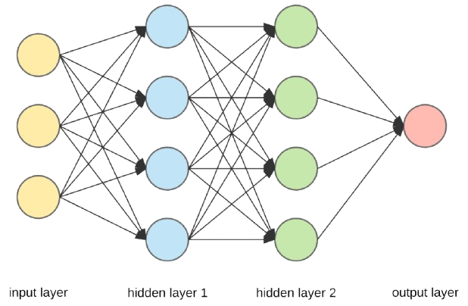
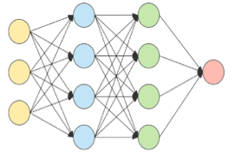
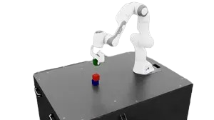
1. Grasp Model
Intermediate
Handoff
(Wrapper)
2. Place Model
(TD3)
3. P-Controller
(Scripted)
7
actions
7
actions
46
obs
46
obs
Deterministic P-Controller for placement
Recenter(XY)
Lower (z)
Open Gripper
Retract
Deterministic handoff from grasp model to place model
Output 7-D actions
(∆x, ∆y, ∆z, ∆r, ∆p, ∆y, gripper)
Output 7-D actions
(∆x, ∆y, ∆z, ∆r, ∆p, ∆y, gripper)
Output 7-D actions
(∆x, ∆y, ∆z, ∆r, ∆p, ∆y, gripper)
Environment
Robosuite PickPlace (MuJoCo)
46-D Observations
1
2
3
4
FSM(Meta-Controller)
Deterministic state machine with stage exit conditions
Grasp
Handoff
Transport
(place mood)
Release
(P-Controller)

